Slide 1

Governance and Compliance with Microsoft Purview A getting started guide 1 - Setup
If you think compliance is complicated, feel free to try incompliance!
Jan Cordtz, Snr. Cloud Solution Architect
Microsoft Denmark
Note – in this document the name Purview – if not otherwise
stated - is used for the Data Governance part of Purview.

Slide 2
Introduction

Slide 3
Today’s data realities
3
What data do I have?
Data governance
Is it trustworthy?
2
Analytics
Can people access the data needed to make the right decisions?
1
Operational Databases
How can I enable faster business insights?
Operational databases
What’s my compliance exposure?

Slide 4
Organizations struggle to secure and govern their data
74%
Can’t secure the data
68%
Can’t activate the data
47%
Can’t adhere to regulations
1. Data Security Index Report
2. 2022 Chief Data Officer survey, Deloitte, 2023.
3. ISMG First Annual Generative AI Study:
Notes:
Despite understanding the key role governance plays, many organizations still struggle to implement effective data democratization.
Customers often struggle with securing the data, activating the data, and adhering to regulatory risks.
74% of companies in a study had some data exposed in the past year
68% of companies report not being able to activate the data to apply the right insights.. Leads to poor data quality
47% of leaders are confident their organization is able to confidently meet AI regulations
Each of these are approached as a siloes today, which leads to these pain points.
Activation means making your data ready for use, analysis, or integration into applications

Slide 5
“Without proper governance and security initiatives within ai, data & analytics are at risk of producing unreliable or compromised results”

Slide 6
Microsoft Purview Comprehensive solutions to help govern, protect and manage your data estate
Understand & govern data
Manage visibility and governance of data assets across your environment
Improve risk & compliance posture
Identify data risks and manage regulatory compliance requirements
Safeguard data, wherever it lives
Protect sensitive data across clouds, apps, and devices
Microsoft ecosystem
Support for multi-cloud, hybrid, SaaS data | Third-party/partner ecosystem
Notes:
Introducing Microsoft Purview!
To help organizations govern and protect data across their multi-cloud, multi-platform data environment, while meeting the compliance requirements they are subject to, we are announcing Microsoft Purview. Microsoft Purview is a comprehensive set of solutions to help govern, protect, and manage your data estate.
Microsoft Purview unifies information protection, data governance, risk management, and compliance solutions so that customers can manage their data all from one place. Now, they can leverage that visibility across their environment to help close exposure gaps, simplify tasks through automation, stay up-to-date with regulatory requirements, and keep their most important asset, data, safe.

Slide 7
Why is data governance so hard for organizations?
Fragmentation
Labor-intensive tasks
We must, but what is it we must do ?
Technical interfaces
Different stake-holders (over time)
Difficult to translate into business value
Centralized Governance
Notes:
But why has it been so hard for organizations?
One of the most common pain points in data governance technology implementation is fragmentation. Many organizations find themselves inundated with tools aimed at governing and managing data. This fragmentation leads to complexity, making it challenging to maintain a unified view of data across the organization. Additionally, these tools have historically been tailored to IT, making this a tedious and centralized process that wasn’t intended to address the core issues of governance. As a result, organizations struggle to ensure data quality, security, and compliance.
Unified Catalog – Atlas
Data Lineage – Collibra, Atlan
Data Quality – Internal custom implemented
The second common pain point is the drudgery of labor intensive tasks associated with data governance. Many organizations find themselves constantly playing catch up, struggling to keep pace with the ever-evolving data landscape. Manual processes, such as data classification, metadata management, and compliance reporting can be time-consuming and prone to error. This can result in the organization on a treadmill of prep and set up-- never really able to put the practice into data governance.
The third challenge in data governance implementation is the tension between centrally managed governance and the demand for agility by the business units. Centralized governance models can sometimes stifle innovation and lead to the emergence of shadow business intelligence (BI) initiatives. Business units may get frustrated and resort to using unauthorized tools and processes to meet their specific needs, bypassing centralized governance protocols, and prone to making mistakes.
Finally, a key pain point in data governance technology implementation is lack of tools well tailored for the roles in the enterprise who need to perform different tasks. Traditional governance tools often catered primarily to IT. But with the datasphere growing at an unprecedented pace, having a business-friendly experiences that cater to self-service by data stewards and data consumers is critical.

Slide 8
Microsoft has faced similar challenges
Data estate expansion
Centralized governance
Decentralized governance
Data silos
Notes:
As we share our journey, we want to provide some of the valuable lessons about building a data governance culture to support overall data and digital transformation. We learned that we how to navigate and identify the key strengths of various governance models, how to secure internal support, establishing robust tracking and accountability mechanisms, and adhering to core principles were the keys to driving ongoing data governance transformation. These lessons highlight the importance of adaptability, stakeholder engagement, and strategic implementation in building an effective data governance culture.
Key challenges we had to overcome:
Organically-grown Data Estates: Our data estates had evolved organically over time, leading to a lack of uniformity and consistency in how data was managed. This organic growth made it difficult to implement a cohesive governance strategy."
Data Silos: Centralized governance resulted in data being trapped in silos, which severely limited accessibility and prevented comprehensive insights. Breaking down these silos was essential to enable better data integration and utilization."
Centralized Governance Hindering Agility: Our centralized governance model, while intended to maintain control, became a barrier to agility. Slow decision-making processes and cumbersome compliance requirements stifled innovation and responsiveness. We needed a more flexible approach to adapt quickly to changing business needs."
Decentralized Governance without Consistent Standards: On the other hand, where decentralized governance was applied, it often lacked consistent standards. This inconsistency led to fragmented data practices and uneven compliance across different parts of the organization. Establishing cohesive standards was critical to ensure uniformity and compliance across all data governance efforts."

Slide 9
Why Microsoft landed on a federated governance approach
Centralized
Federated
Decentralized
Responsibility at the Core
Agility at the Edge
Responsibility at the Core
Agility at the Edge
Responsibility at the Core
Agility at the Edge
Source : Forrester Research. Map a path to Federated Data Governance
Notes:
As we look to scale data governance, there are three broad operating models to consider. At Microsoft, we have lived through all three models in the last 5-8 years.
We began with a centralized model. This model is where you have a single team, typical a data office in an IT organization, which is accountable for managing the entire enterprise data estate. This can help you harden your controls and keep your data estate secure and compliant. The challenge with this model is when everything is gated through one team it will impact agility of the business to innovate and apply data in free and unique ways.
The next model we navigated was the decentralized model. This brings significant agility at the edge and enables business teams to innovate faster but comes with the cost of not being able to realize the efficiencies that can be gained by standardized and making more common the security compliance and privacy aspects of your data estate.
The industry is now converging towards a federated data governance model. This gives you the best of both. It enables you to maintain commonalities and consistent operations while enabling those capabilities to responsible democratize data to broader organization-wide functions and users who can self-serve in managing their data estate in discovering, understanding, accessing and applying data.
We at Microsoft firmly believe in the federated data governance model and in enabling these business users to rapidly accelerate business innovation with data.
Additional notes for speaker if needed:
Key Benefits:
Autonomy and Control: Local customization under a unified strategy.
Responsiveness and Agility: Quick adaptation to department-specific needs.
Scalability: Adapts to growth and changes in organizational structure.
Compliance Assurance: Maintains overarching compliance while allowing local variations.
Collaboration: Promotes knowledge sharing and best practice dissemination across units.
Why the Shift is Important:
Complex Data Landscapes: Manages increasing data intricacy efficiently.
Regulatory Compliance: Meets stringent global data protection laws.
Business Agility: Supports rapid response to market changes.
Organizational Decentralization: Suits geographically and operationally diverse entities.

Slide 10

Unified platform to secure & govern your multi-cloud data estate
Microsoft Purview
DATA SECURITY
DATA GOVERNANCE
DATA COMPLIANCE
Secure data across its lifecycle, wherever it lives
Responsibly unlock value creation from data
Manage critical risks and regulatory requirements
Data Loss Prevention
Insider Risk Management
Information Protection
Data Catalog
Data Quality
Data Lineage
Data Estate Health
Compliance Manager
eDiscovery and Audit
Communication Compliance
Data Lifecycle Management
Records Management
Unstructured & Structured data
Traditional and AI generated data
Microsoft 365 and Multi-cloud
Shared platform capabilities
AI-based efficiency, Discovery, Classification, Labels, Rules, Policies, Data Connectors
Notes:
The Microsoft Purview family is here to help you govern and protect data across multi-cloud, multi-platform data environment, while helping you meet compliance requirements you may be subject to; helping you with your data security, data governance and data compliance needs.
Purview brings simplicity with a comprehensive set of solutions built on a platform of shared capabilities, that helps keep your most important asset, data, safe.
Notes
Data Governance is overloaded (Info Governance as well)
Data Governance is not needed to do security and compliance for Copilot for M365
Consider alternative ways to avoid ‘Data Governance’ overloading

Slide 11












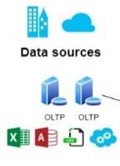
A federated practice paired with user-friendly tools
Data Consumers
Quickly find and use relevant, trusted datasets through streamlined access request workflow.
Domains
Data Owners
Sales
Marketing
Human
Resources
Operations
Finance
Sustainability
Register data assets for use, manage classifications and access, and ensure high quality standards.
Ensure data quality, seamless data discovery, glossary consistency, and lineage. Work with central office.
Data Stewards
Unified Catalog
Data Health Management
Central Data Office
Establish and ensure governance policies, active metadata, compliance, and insights into overall governance health.
Azure
Data Lake Storage
Google Cloud Storage
Databricks
Fabric
Snowflake
Azure
Cosmos DB
Azure
SQLDB
Mongo
DB
Cloud stores
Databases
All other sources
Notes:
And it’s critical that technology simplifies the way each data professional in your organization manages, discovers, and accesses data. With a solution built for each role, business domain experts can accelerate data value while your data office and stewards provide the standards for consistent operations and can maintain commonalities. It’s all about seamlessly enabling responsible data democratization and federated governance.

Slide 12
Microsoft Purview brings together solutions from our compliance and data governance portfolios
Frontend
Backend
Risk & compliance
For risk, compliance, and legal teams
Data Map
Data Catalog
Data Quality
Data Estate Insights
Microsoft Purview
Information Protection
Data Loss Prevention
Data Lifecycle Management
Data Connectors
Insider Risk Management
eDiscovery
Audit
Records Management
Communication Compliance
Compliance Manager
Unified data governance
For data consumers, data engineers, data officers
Notes:
With Microsoft Purview we bring together compliance and data governance
The risk and compliance portfolio joins with our unified data governance

Slide 13
Purview Data Governance “surroundings”

Slide 14
The Pillars
Can be used to determine the access at given point in time (policies)
Sensitivity Labels
Classifications
Identities
The device
The agent
How can I use the data
What does the data contain
Who is it (Processes could have an identity)
The device to be enrolled
Promting (Co-Pilot)

Slide 15
The “Workflow”
Where can I store files ? OneDrive / USB / Local
Which resources can the device use ? Storage/Network
The device
The File
How does the data move around ? Sharing / Mail / ETL
The program
The Data
Which programs may I use ? Software management / licensing
The movement
Who am I ? Login / MFA / Groups
What data can I work with ? Jobprofile/organization
The Database
Which databases can I access ? Connection / Row Level
The identity
(managed indetities)

Slide 16
Getting their – wherever that is
As we can not do everything in one go – focus on the riskiest elements (most likely mail and prompting)
Establish solid(few) labels that makes sense (Pub, Int, Sec) – Protection
Start using these on specific business areas
Educate the business in using those labels
Establish the first classifications - GDPR
Start scanning and classify documents
Create policies – protect e-mails

Slide 17
Organization
Management
Governance office
It Security
Business Unit
Business Unit
Auditor
Sanctions
Defines/plans/ Educates
Controls
Implements
Uses/Adheres

Slide 18
The tooling
Entra ID
Handles users, groups, managed identities, MFA
Purview Compliance OneDrive, Sharepoint, Fabric, Sensitivity labes, CoPilots
Intune Handles enrollments, devices, updates
Purview Data Governance
Azure Network, services,
Apps
Workflow Automation, approvals, enforcement of data rights
API’s
Apache Atlas/Purview API, openness, extensible

Slide 19

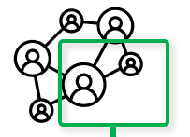











Microsoft Purview - detailed
Enterprise Data Model
Microsoft Copilot
Enriches
Microsoft Purview
Information Protection
Sensitivity labels
Microsoft Purview Data Governance
Data Catalogue
Enterprise Glossary
Data Map
Governance Domain 1
Governance Domain n
Links Tech Metadata and Lineage
Interacts
Default Domain
Domain (1-4)
Data Product 1
Data Product n+1
Collection 1
Collection 1
End Users
Data Product n
Data Product n+n
Provides
Collection 2
Collection 2
Collection 3
Collection 3
Assessing
Microsoft Purview
Solutions (cont.)
Audit
Data Lifecycle Management
Workflows
Data Policy
Data Loss Prevention
AI Hub
Communication Compliance
eDiscovery
Information Barriers
Records Management
Data Health & Quality Process
Data Governance Application APIs
3rd Party Process
& Applications
Scanning/Classification
Communicates
Sources

Slide 20
Topics of interest
Naming standards
Ownership / ambassadors / management support
Education
Enforcement / providing insight
Guardrails
How to organize the data map – domains/collections
How to organize the data products / governance domains
“Domain” name used many places/tools

Slide 21
Get Purview Data Governance running

Slide 22
The Purview “Process”
Installation
Establish Domains
Data Map
Unified Catalog
Establish Governance Domains
Establish Collections
Establish Data Products
Register Sources
Connect assets to Data Products -> Governed assets ($)
Establish assets
Scan
API
Enhance assets
Descriptions (scan?)
Owners
Lineage (scan?)
Glossaries
Classification (scan?)
Sensitivity
Enhance data product
Owners
Glossaries
OKR
Critial Data elements
Data Access
Advanced
Api’s
Workflows
Enforcement of rights

Slide 23
Installation

Slide 24
Note
The new Purview Portal can only exist once per tenant.
If you already have one – or more – instances of Purview click here otherwise continue.

Slide 25
Requirement
The user account that you use to sign in to Azure must be a member of the contributor or owner role, or an administrator of the Azure subscription being used for Purview. To view the permissions that you have in the subscription, follow these steps:
Go to the Azure portal
Select your username in the upper-right corner.
Select the ellipsis button ("...") for more options.
Then select My permissions.
If you have access to multiple subscriptions, select the appropriate subscription.
Step 1 - Suggested pre-requisite
Create a standalone subscription for Purview

Slide 26
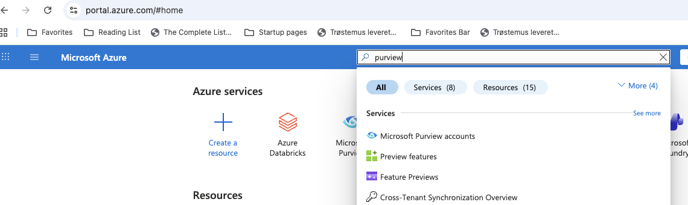
Step 2 – Establish Purview using the Azure Portal
Search for purview in the search bar of the Azure Portal
Select Microsoft Purview accounts from the result list

Slide 27
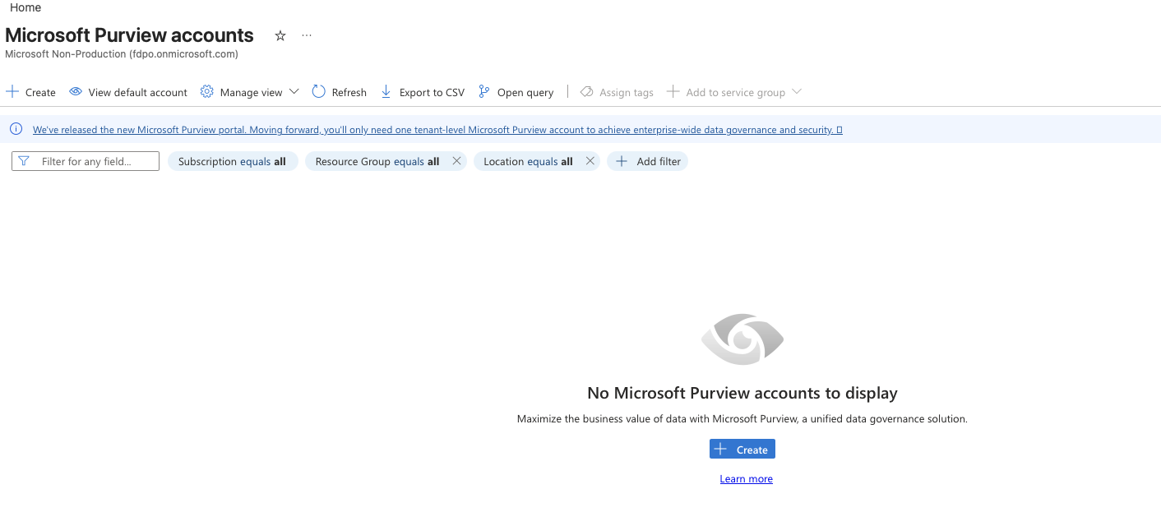
Step 3 – Choose Create on the Purview Account screen

Slide 28
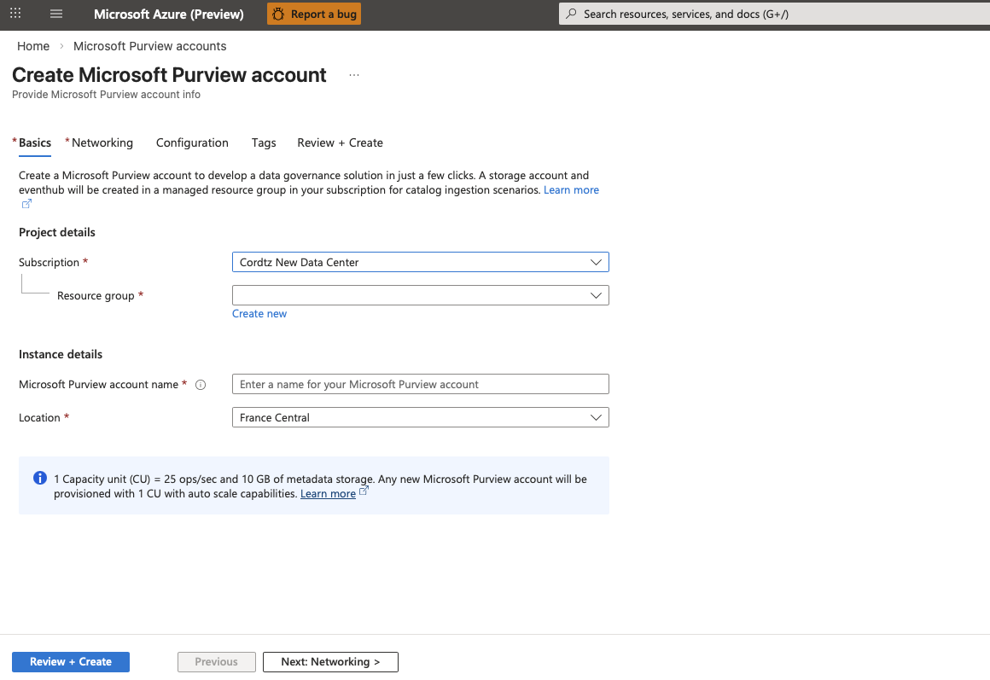
Step 4 – Fill out the information on the Basics tab
Choose the subscription of choice
Choose or create a new Resource group Suggestion: Purview should be in its own Resource Group
Give your Purview instance a Name
Choose your desired Azure Location

Slide 29
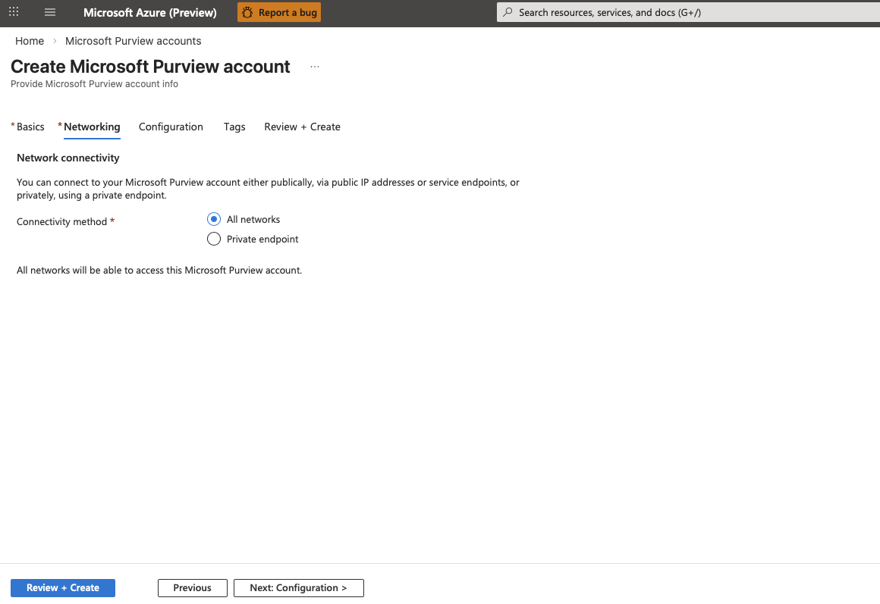
Step 4 – If needed change the information on the Networking tab
All networks makes Purview available as Public cloud service.
If you choose Private Endpoints please follow these instructions

Slide 30
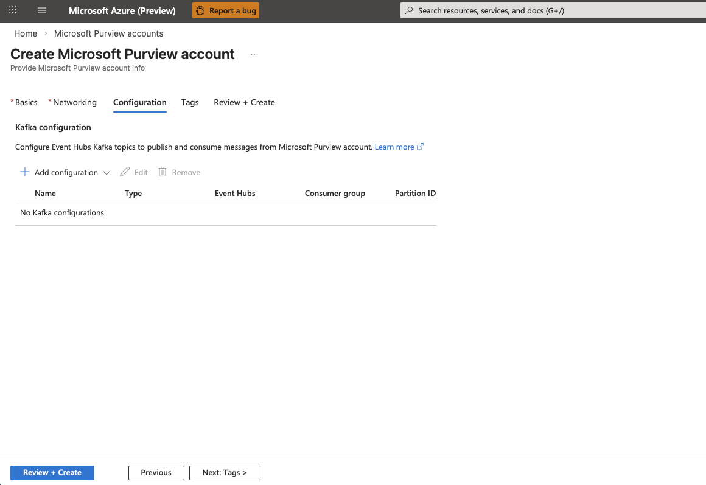
Step 4 (optional) – If you like to enable publishing and consuming messages from Purview using Kafka add a configuration for this on the Configuration tab
Add a configuration for your Kafka setup

Slide 31
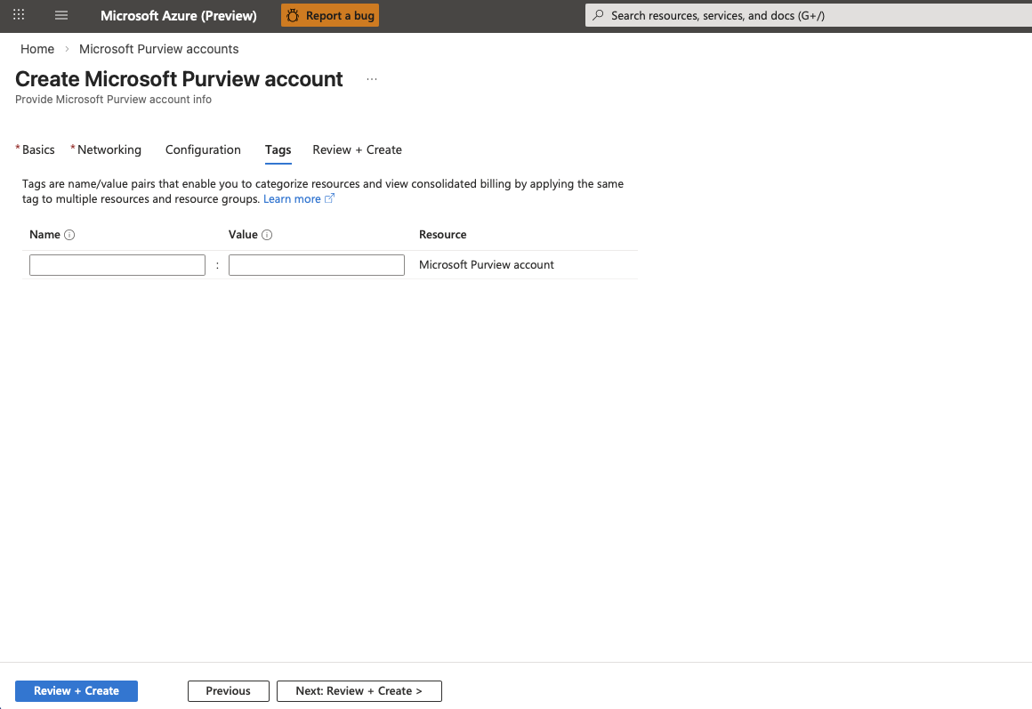
Step 5 (optional) – Add any (required) tags on the Tags tab
Add any (required) tags for your Purview account

Slide 32
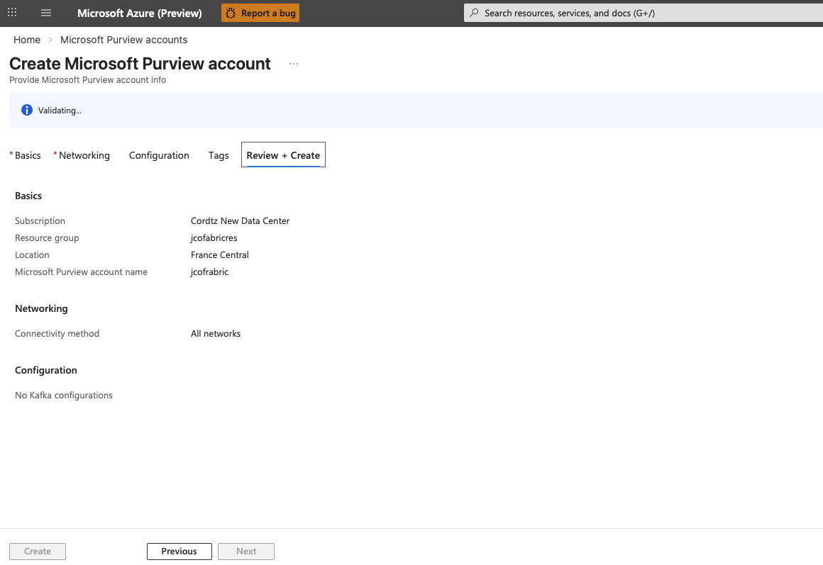
Step 6 – Check the Review + Create tab
If things are in order press Create otherwise go back on the tabs and change accordingly

Slide 33
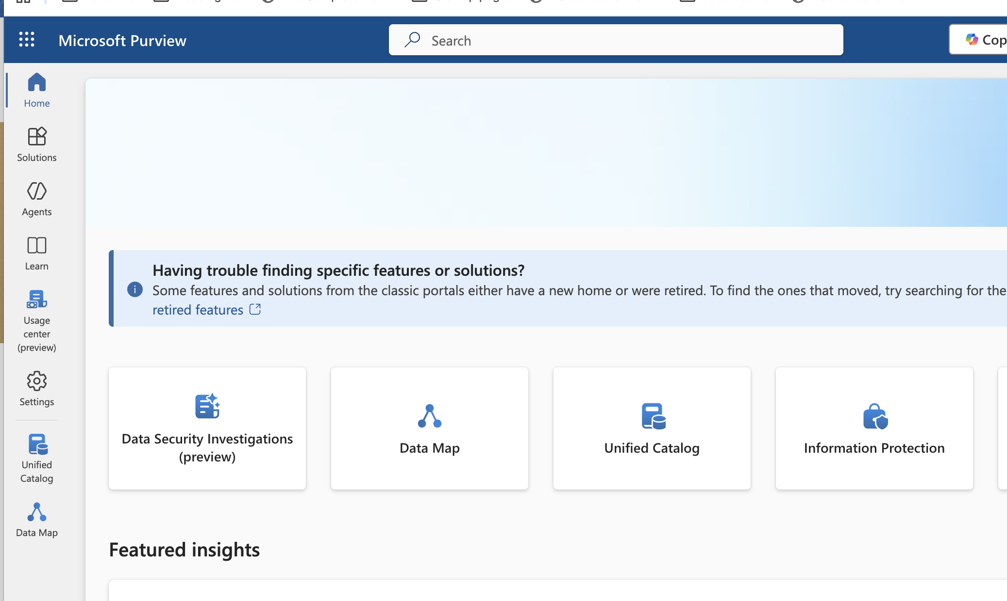
Step 7 – After installation tasks
If the person who created the Purview instance is NOT to be the owner of the Purview content/process, you need to change the ownership in the Purview Portal.
Step 7a – login into the Purview Portal with the login of the user who created the Purview Instance. And navigate to the Data Map

Slide 34
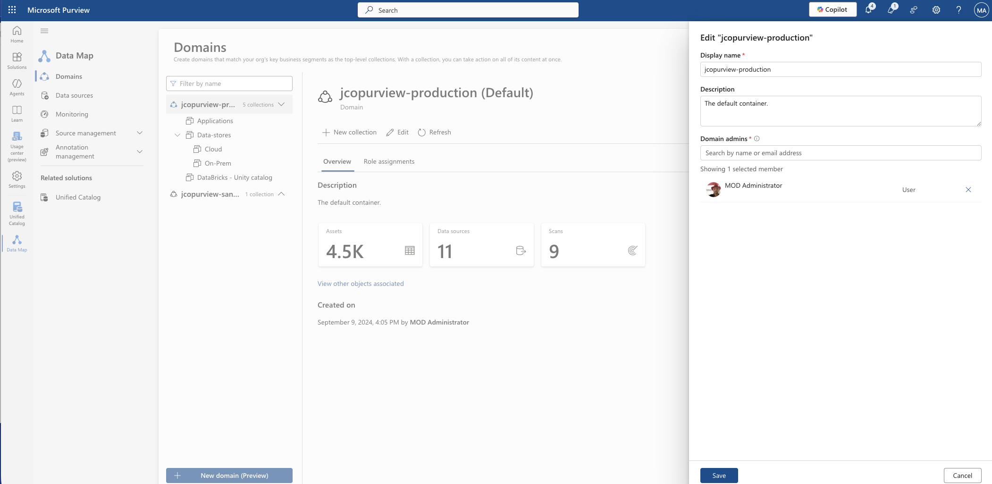
Step 8 – Rename the default domain (optional)
If you would like to change the name of the default domain that can be done choosing the edit button. You can rename the default domain at any time.
In the Data Map navigate to Domains
Choose the top (default) domain.
Click the edit button and then you can change the name as well as a description. Press save to save.

Slide 35
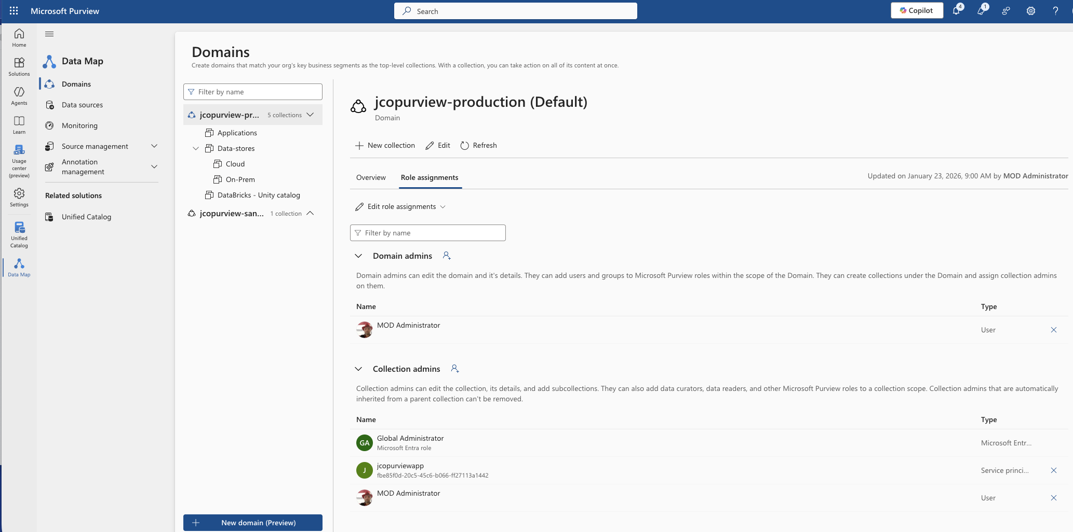
Step 9 – Assign right owner in the Purview Portal.
In the Data Map navigate to Domains
Click Role Assignments
Under Collection Admin add the right person/group – and (maybe) remove the creator of the Purview Instance. It then this group/person task to assign further rights in Purview. Note: Purview rights is NOT maintained in Entra ID but in Purview.
Installation

